Slide 1

Stationery Amnesty
10 point plan
Daniel O’Connor
Daniel@GetWarpIt.com
Warp It Reuse Network

Slide 2
Overview
What is it?
Why is it important?
The approach
The 10 point plan
Free resources
  Communication materials
  Action Plan

Slide 3

What is it?

Slide 4
Why is it important?

Slide 5
Keystone habits in organisations

Slide 6
Approach
Incremental roll out
Test>Improve>Test>Improve
Create a demand
Monitor
Illustrate benefit
Repeat
Bigger reuse projects

Slide 7
Step 1:
Accept there will be barriers and overcome them
Will not happen overnight
Persistence
Recognize enthusiasm dips
Take breaks
Look how far you have come

Slide 8
Step 2:
Set a Goal
Define success
Align with existing strategy

Slide 9
Step 3:
Develop a plan

Slide 10
Step 4:
Milestones
Break down the project
Set short deadlines
Milestones
When you hit each milestone celebrate

Slide 11
Step 5:
The Pilot
The Team
Pilot department
Publicise results
2nd Pilot

Slide 12
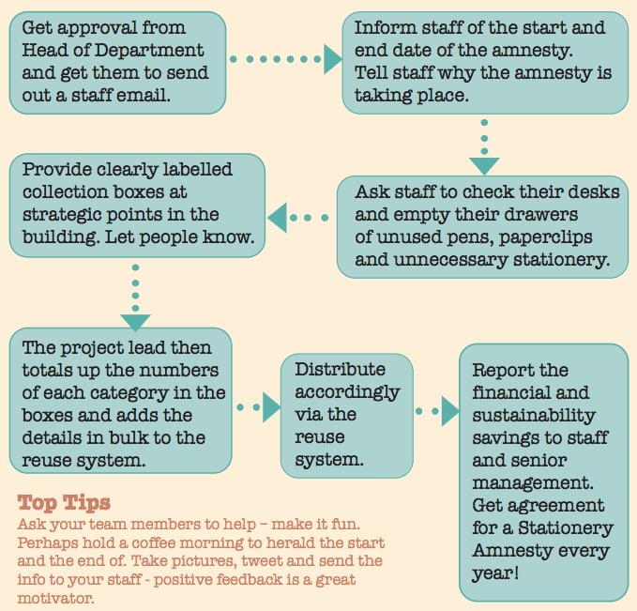
Step 6:
Develop Local Plan

Slide 13
Step 7:
The humble copy paper box

Slide 14
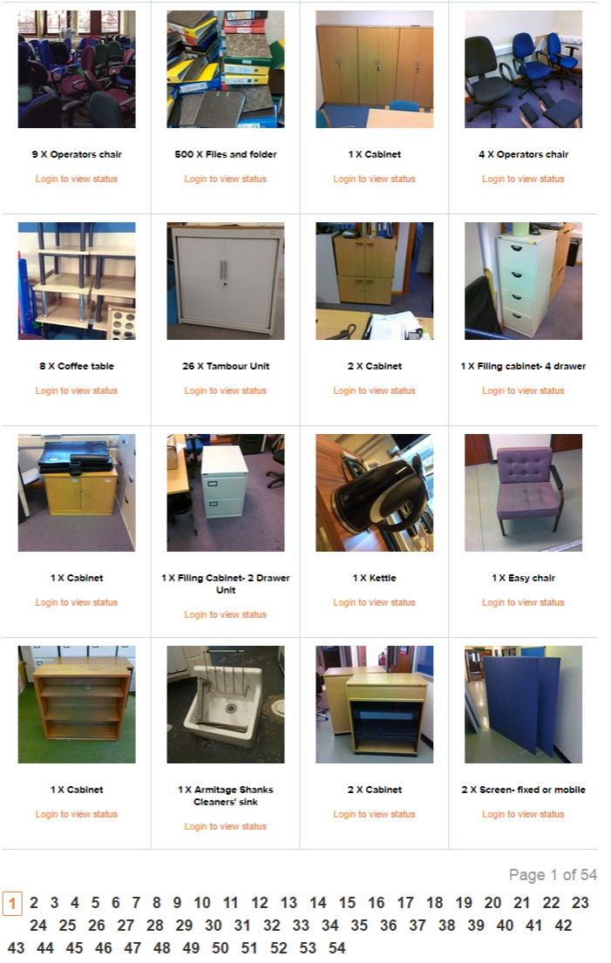
Step 8:
Total .
Add to reuse system

Slide 15
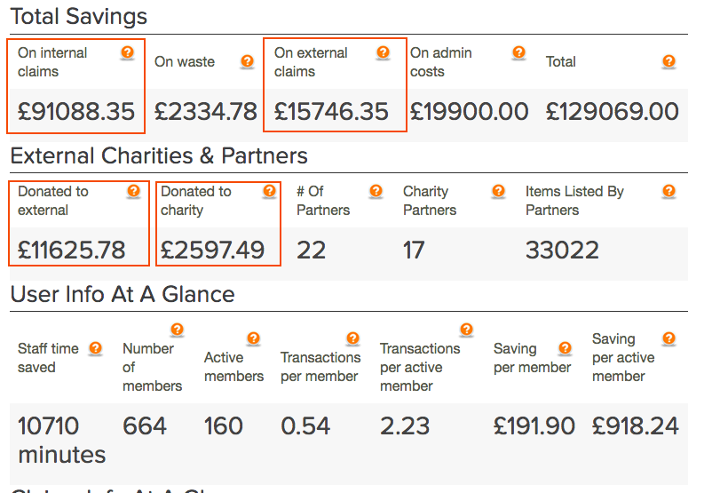
Step 9:
Track financial and environmental savings

Slide 16
Step 10:
Tell everyone about it and your crazy target!
Top tip:
Create a demand using scarcity

Slide 17
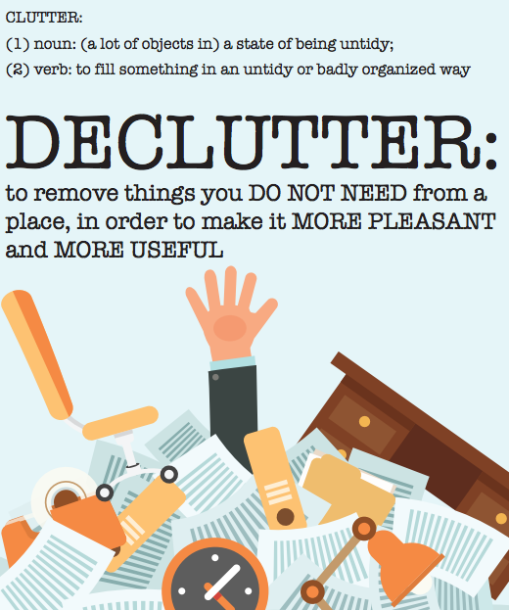
Bonus Step 11:
You made it happen!
What next?!

Slide 18
Free Resources
Communication materials
Action plan spreadsheet
Help and advice

Slide 19
Warp It Reuse Network
Daniel O’Connor
Daniel@warp-it.co.uk

Slide 20

Internal Collaboration

Slide 21
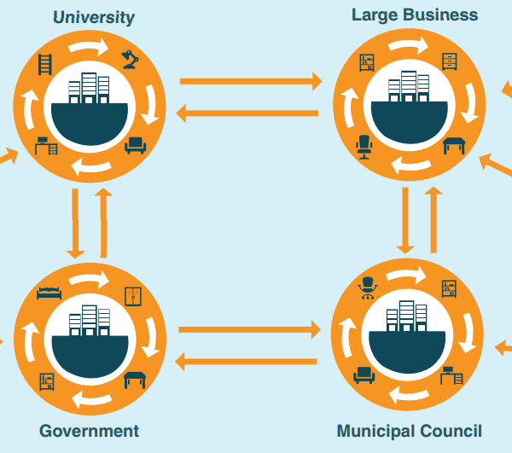
Friend requests

Slide 22
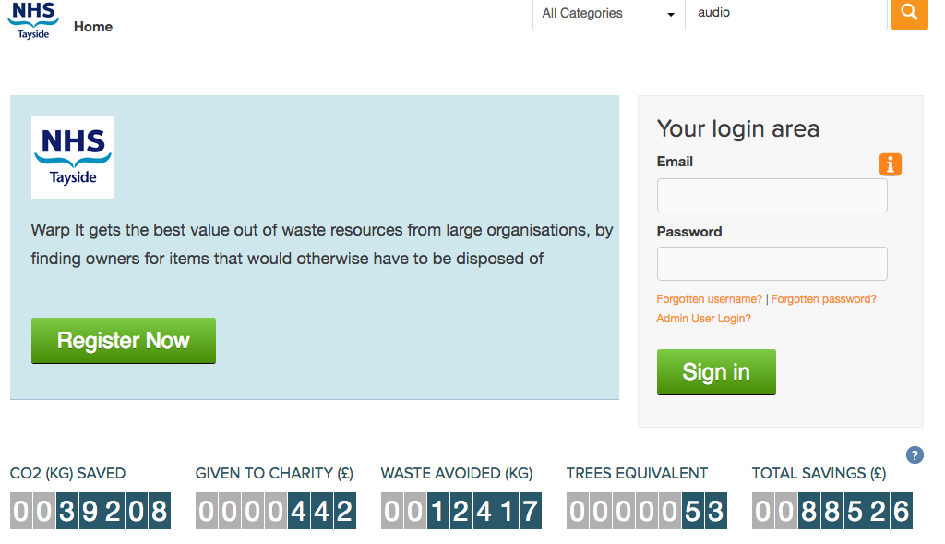

Slide 23
One place on line.
Reduces emails
Reduces visits
Saves time
Improves safety
Increased participation

Slide 24
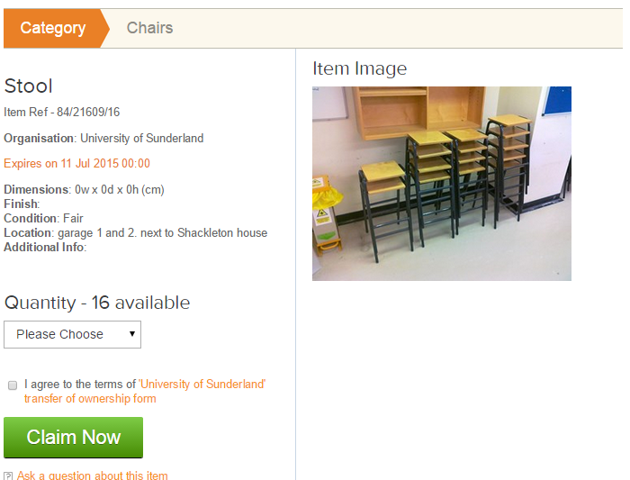
System tracks trades.
Saves time.
Easy Management.
Audit trail.

Slide 25
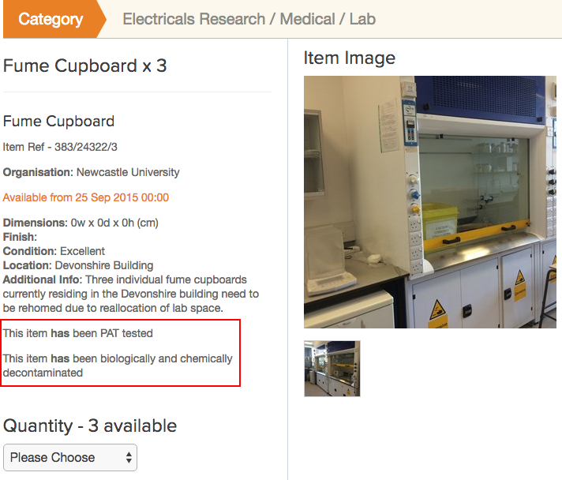
Safety Checks
Diverse range of equipment- increase participation.
Maximises reuse.

Slide 26
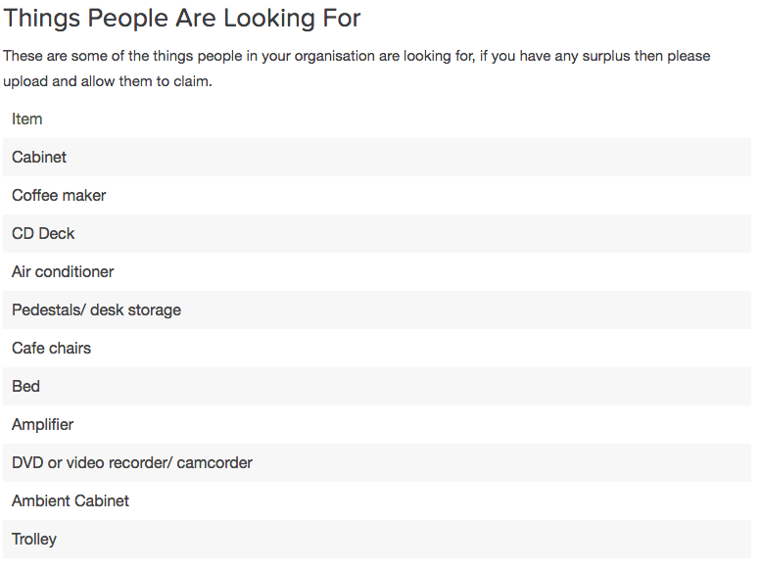
Wishlists
Direct transfer- no double handling

Slide 27
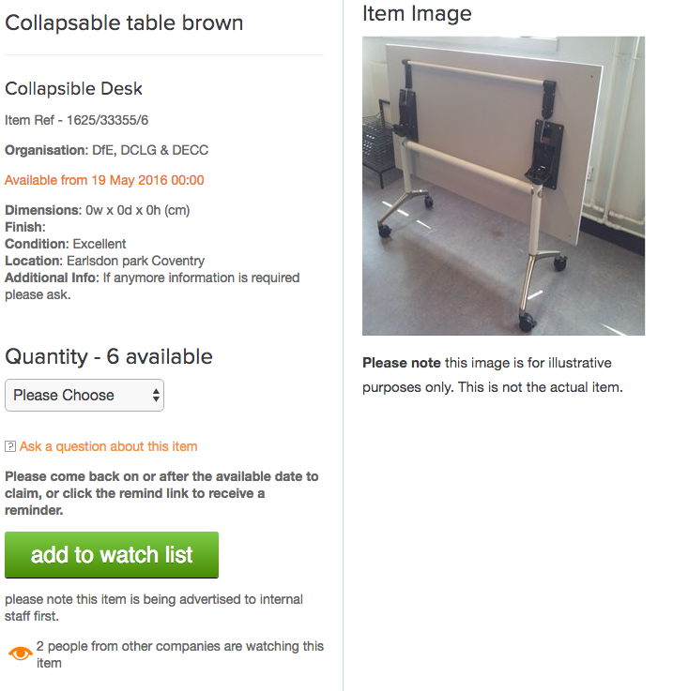
Watchlists
Plan building moves.
Direct transfer.

Slide 28

Win win win

Slide 29
Demonstrate savings.
Metrics from NHS Tayside

Slide 30
Stationery Amnesty
10 point plan
Daniel O’Connor
Daniel@GetWarpIt.com
Warp It Reuse Network

